Slide 1
Warehouse and Retail Sales Dashboard (2017–2020)

Slide 2
INTRODUCTION
This project analyzes the warehouse and retail sales performance of the Montgomery County Alcohol Beverage Services (ABS).
The dataset includes real-time business data such as item type, supplier, retail and warehouse sales, and yearly performance.
The aim is to explore, analyze, and visualize key sales insights using Power BI.
Objective:
To clean, prepare, and visualize business-related data using Power BI.
To identify key performance indicators (KPIs) such as Total Retail Sales, Warehouse Sales, and Average Retail Sales.
To analyze sales trends over time.
To create an interactive dashboard providing clear and concise business insights.

Slide 3
DATASET DESCRIPTION
Dataset Name: Warehouse and Retail Sales Dataset
Source: Montgomery County Open Data Portal
Attributes:
  ITEM CODE – Unique identifier for each product
  ITEM DESCRIPTION – Name of the product
  ITEM TYPE – Category (Wine, Beer, Liquor, etc.)
  RETAIL SALES – Sales value from retail stores
  RETAIL TRANSFERS – Transferred sales data
  WAREHOUSE SALES – Sales through warehouse distribution
  SUPPLIER – Product supplier
  YEAR – Year of sale

Slide 4
DATA PREPARATION AND MODELLING
Imported the CSV file into Power BI Desktop.
Checked for data types (numeric, text, year).
Created calculated measures using DAX (Data Analysis Expressions):
  Total Retail Sales = SUM([RETAIL SALES])
  Total Warehouse Sales = SUM([WAREHOUSE SALES])
  Average Retail Sales = AVERAGE([RETAIL SALES])
Built relationships between fields and formatted values for readability (M, K).

Slide 5
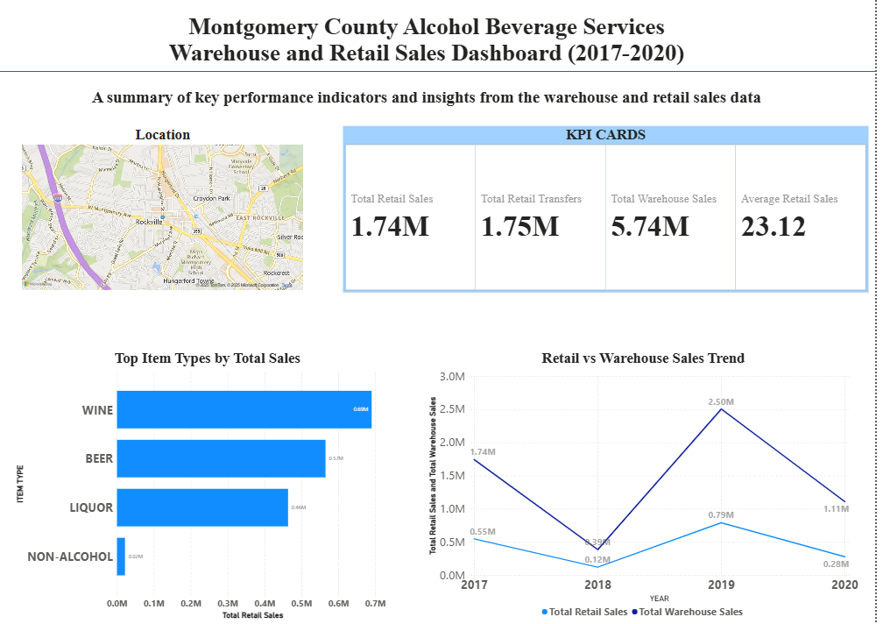
DASHBOARD DESIGN OVERVIEW
This dashboard provides a summarized visualization of the warehouse and retail sales data.
It includes key metrics, sales trends, and category-wise insights for the years 2017–2020.
Dashboard Title: Montgomery County Alcohol Beverage Services – Sales Dashboard (2017–2020)
Sections Included:
Map Visual – Location of the company (Montgomery County, Maryland)
KPI Cards – Key metrics such as Total Retail Sales, Total Transfers, Warehouse Sales, and Average Retail Sales
Bar Chart – Top 5 Item Types by Total Sales
Pie Chart – Comparison of Retail vs Warehouse Sales
Line Chart – Trend of Retail and Warehouse Sales by Year

Slide 6
INSIGHTS:
Top Item Types: Wine and Beer recorded the highest sales among categories.
Warehouse Sales: Contribute over 75% of total sales, showing strong wholesale distribution.
Retail Sales Trend: Steady growth after 2018 with peak performance in 2019.
Average Retail Sales: Consistent sales per item indicate stable retail demand.
Geographic Insight: Sales and operations centered in Montgomery County, Maryland.

Slide 7
CONCLUSION
The Power BI dashboard provides a comprehensive overview of sales performance between 2017–2020.
It helps identify top-performing product categories and yearly sales trends.
The visualization enables data-driven decision-making for inventory and marketing strategies.
The project demonstrates the end-to-end data science process: collection, cleaning, analysis, visualization, and interpretation.

